Slide 1
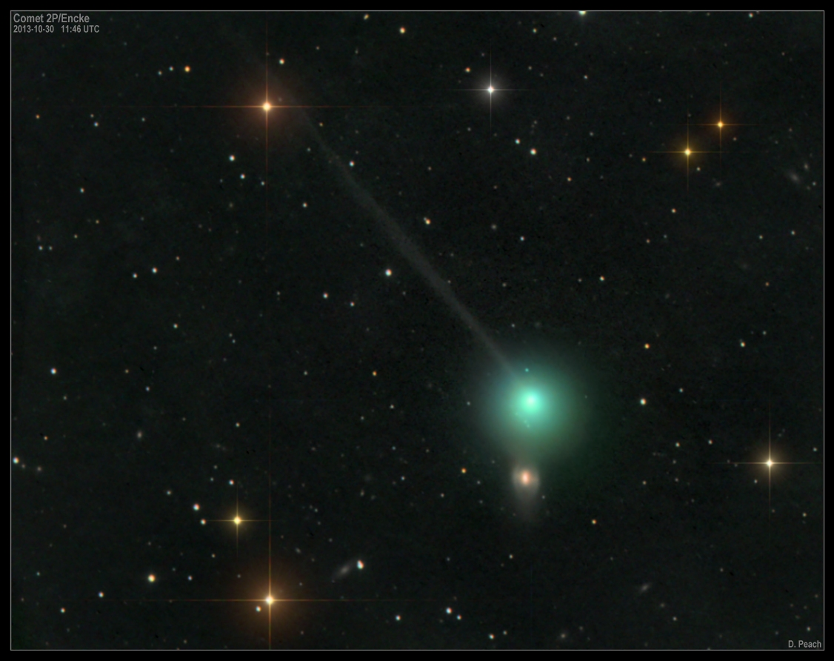
Comet Encke

Slide 2
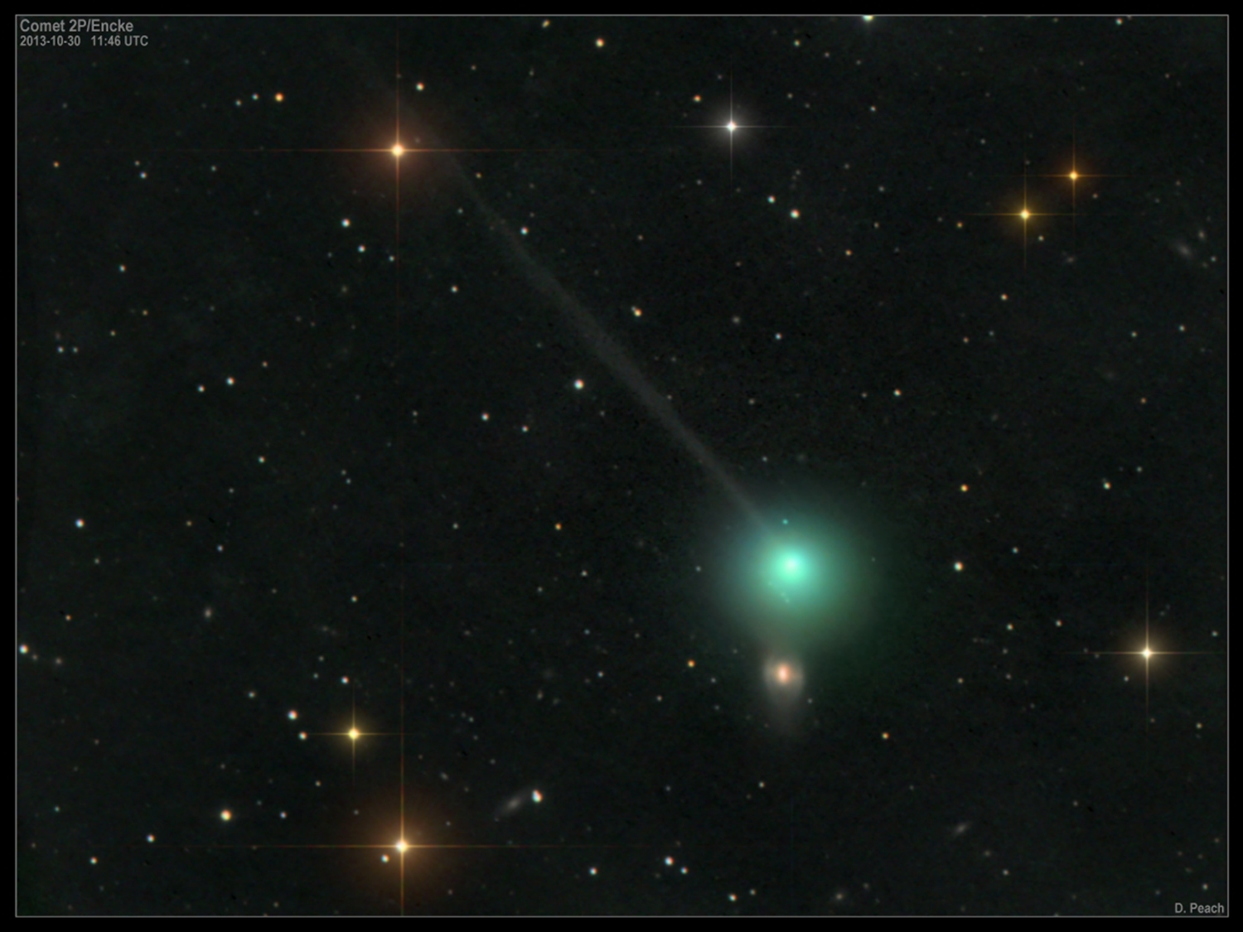
Comet Encke
Diameter: about 3 miles
Orbital Period: 3.3 years
Astronomers call it
“Old Faithful”
because of its
short orbital period
and consistent appearances.

Slide 3
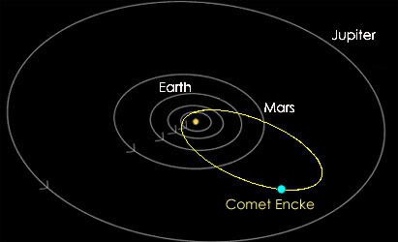

Slide 4
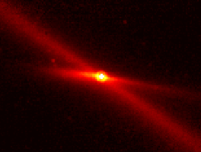
Comet Encke
First recorded by Pierre Mechain in 1786.
It was the 2nd period comet discovered (the first was Halley’s Comet).

Slide 5
Johann Franz Encke computed its orbit after linking comet observations in 1786, 1795, 1805, and 1818.
He published his findings in 1819 and correctly predicted its return in 1822.

Slide 6
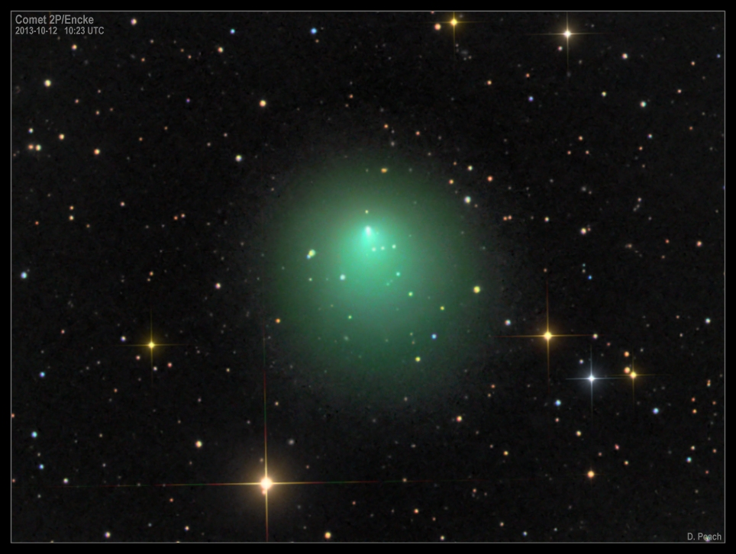
Comet Encke
It has the shortest period of any known comet.
It has been observed at every approach since its discovery in 1819.

Slide 7
The comet seems to be fading since 1786. Its brightest recorded magnitude was 3.5 in 1829.
It has not been observed brighter than 5.0 since the 1800s.
(lower #s mean brighter magnitude)

Slide 8
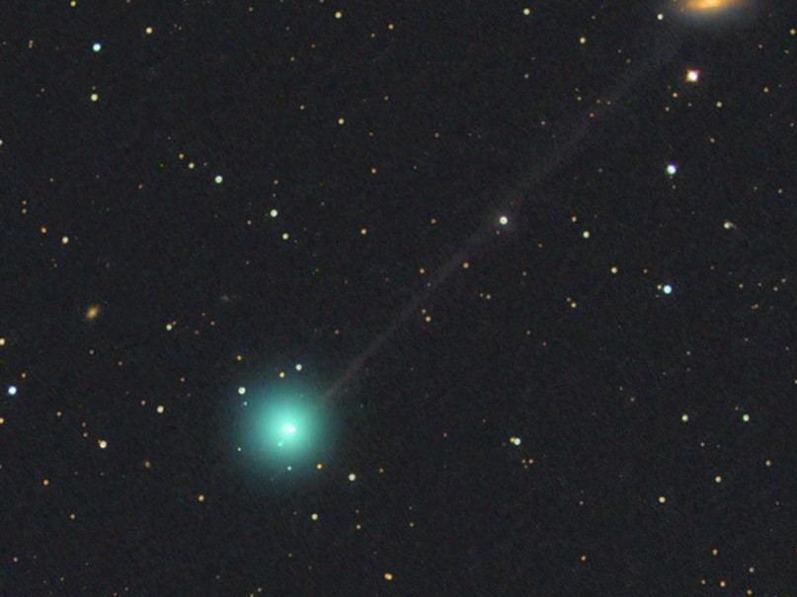
Comet Encke
The longest recorded tail was 3 degrees in 1805.
It reached as long as 2 degrees in 1871 & 1961.

Slide 9
Comet Encke
It comes as close as 0.17 AU to Earth and will next be that close on June 29, 2172.
Close approaches to Earth usually come every 33 years.

Slide 10
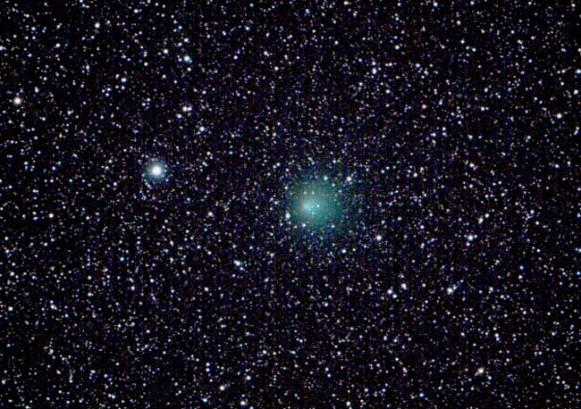
Like most comets, it has a very low albedo, reflecting only 4.6% of the light it receives.
Comet Encke

Slide 11
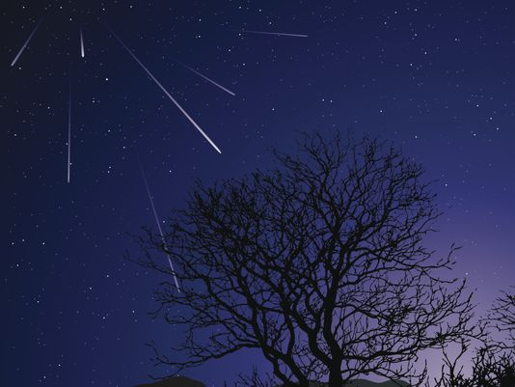
Comet Encke is likely responsible for the Taurids meteor shower that happens in late October & early November every year.

Slide 12
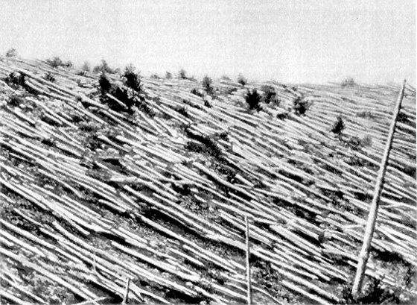
A piece of Comet Encke is thought to have caused the Tunguska Event in 1908.

Slide 13
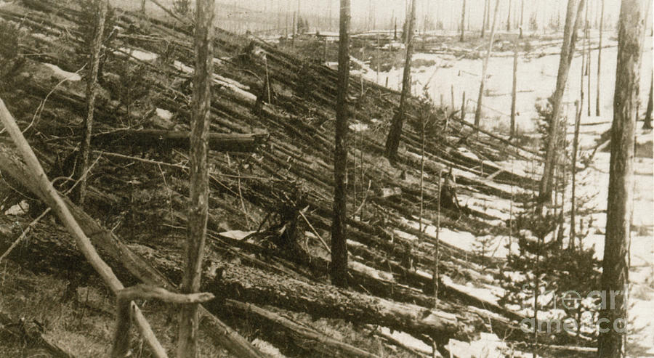
On June 30, 1908 the largest meteoroid impact in recorded history happened over Tunguska, Siberia. 770 square miles of forest were decimated, likely by a piece of Comet Encke.

Slide 14
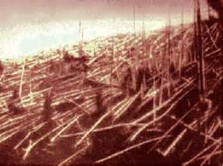
The meteor (likely from Comet Encke) had a diameter of 200 – 650 feet.
There were no
casualties.

Slide 15
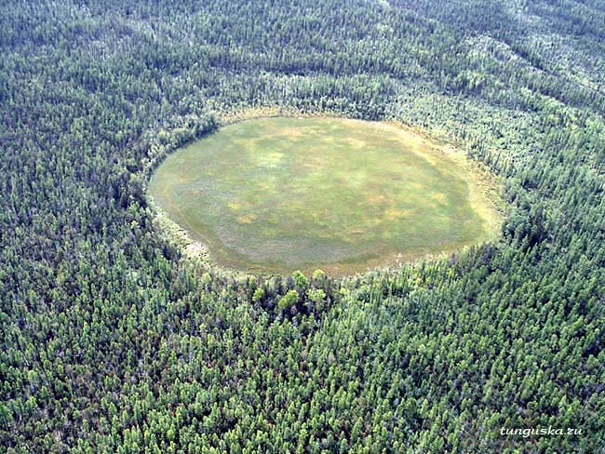
No pieces of the Tunguska meteor have ever been recovered, so it must’ve burned up completely in the atmosphere.

Slide 16
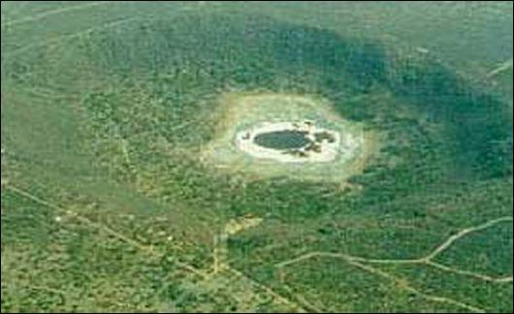
The energy from the Tunguska meteor was equivalent to 1,000 Hiroshima bombs
(15 megatons of TNT).
It hit 5.0 on the Richter scale.

